Slide 1
Binary Trees
Chapter 6

Slide 2
Objectives
Trees, Binary Trees, and Binary Search Trees
Tree Traversal
Implementing Binary Trees
Binary Search Tree
Insertion
Deletion
Balancing a Tree
The DSW Algorithm (*)
AVL Trees
Heaps
Polish Notation and Expression Trees (*)
Reading at home
Notes:
Note: (*) Means that students are required to understand essential features only (the problem explanation, definitions, the outline of algorithms…), not in details.

Slide 3
Polish notation
(Prefix notation)

Slide 4
Polish Notation and Expression Trees
Polish notation is a special notation for propositional logic that eliminates all parentheses from formulas
(5-6)*7 = *-567
Compiler rejects everything that is not essential to retrieve the proper meaning of formulas

Slide 5
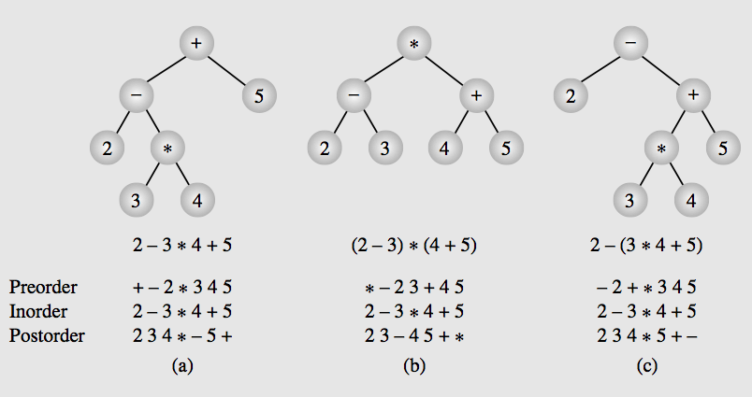
Expression trees & their traversals

Slide 6
Heap
Particular kind of binary tree, called heap, has two properties
Value of each node is greater than or equal to the values of its children
The tree is nearly complete, i.e. it is perfectly balanced, and leaves in the last level are all in the left most positions first.
These two properties define a max heap.
If “greater” in the first property is replaced with “less”, then the definition specifies a min heap.
Heap is used as Priority Queue and for heap-sorting

Slide 7
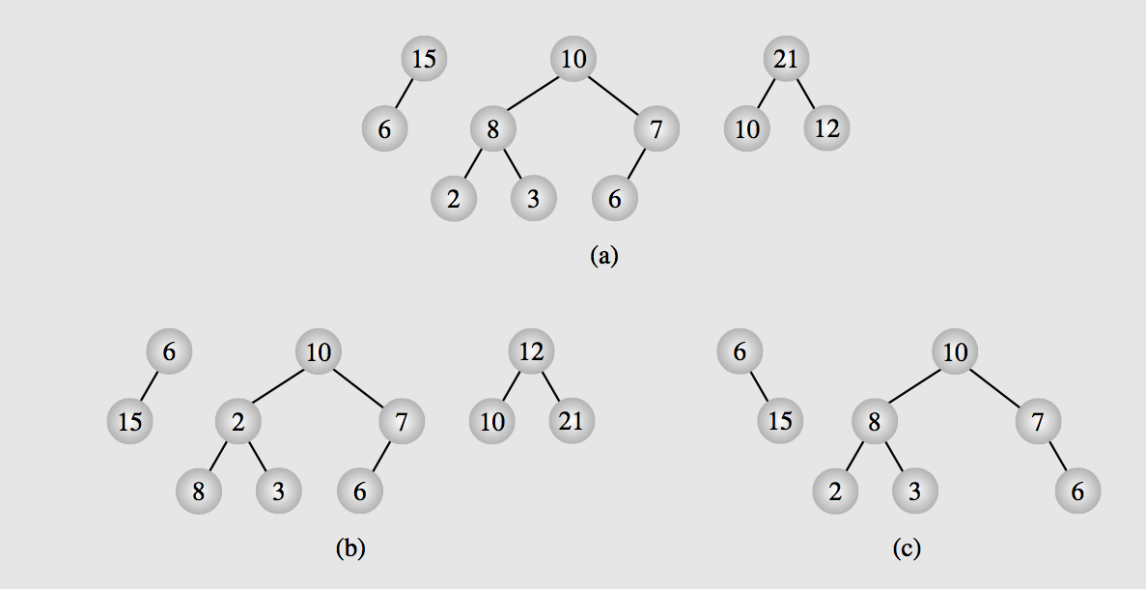
Examples of heaps and non-heap
Notes:
heaps (a) and non-heaps (b, c)

Slide 8
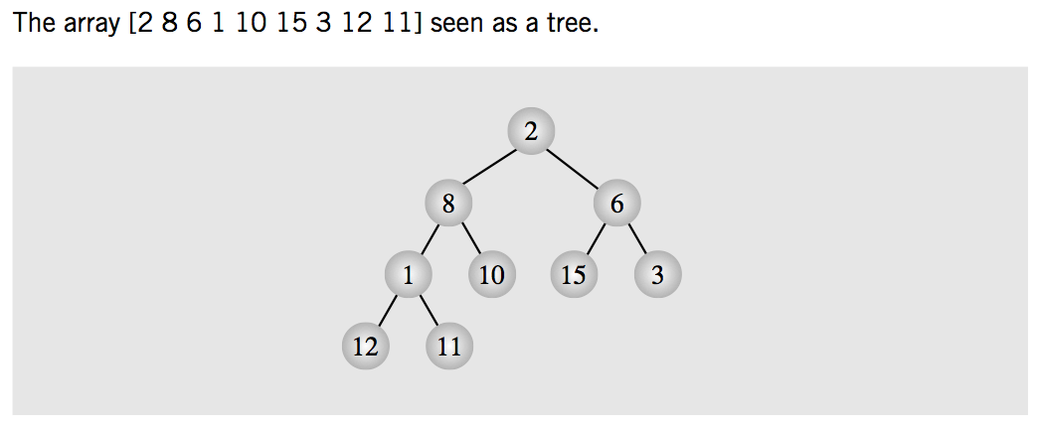
Heaps can be implemented by arrays
Array seen as tree (probably non-heap)
Non-heap tree:
Elements of array are placed sequentially level to level and left to right

Slide 9
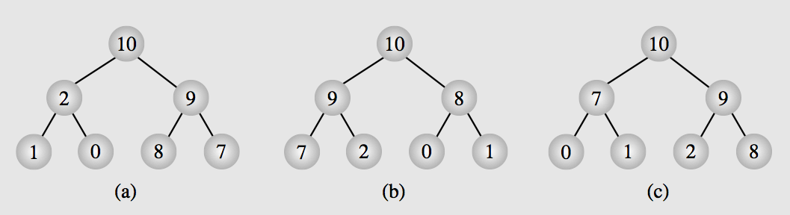
Heaps can be implemented by arrays
Array seen as heap tree
Array can be represented by many heaps
Since heap only decides the order from level to level, not among siblings (same level)

Slide 10
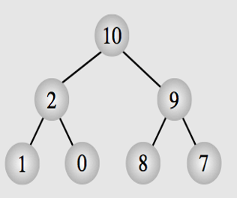
Parent p, left child c1=2*p+1, right child c2=2*p+2
0
1
2
3
4
5
6
Child c=(1, 3, 5, ..) then c is left, parent at (c-1)/2
Child c=(2, 4, 6, ..) then c is right, parent at (c-2)/2

Slide 11
Priority Queue
via heap

Slide 12
Heaps as Priority Queues
Heap is an excellent way to implement a priority queue.
Two procedures needed to enqueue and dequeue elements from this heap.

Slide 13
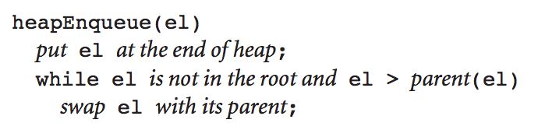
Enqueue to a Heap
To enqueue, element is added at the end of the heap as last leaf
Restoring the heap property is achieved by moving from the last leaf toward the root.

Slide 14
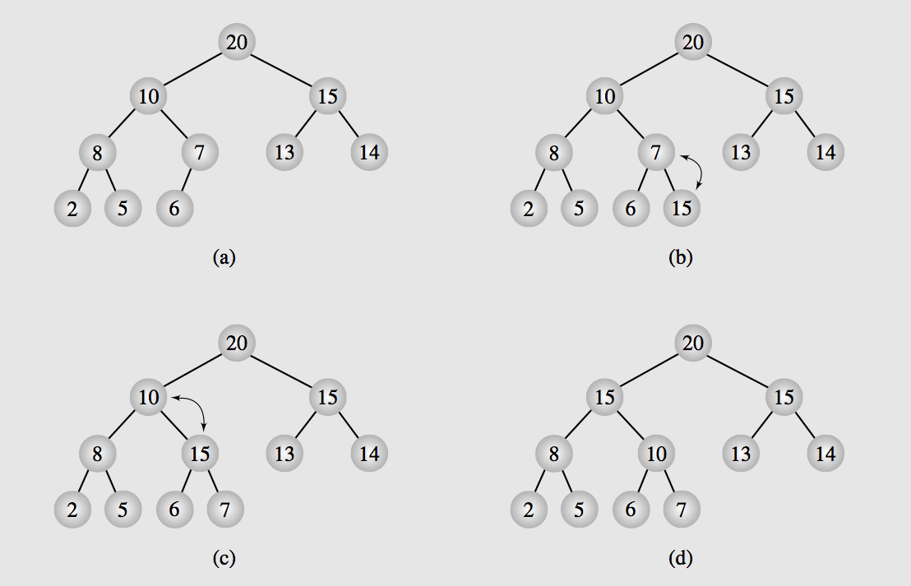
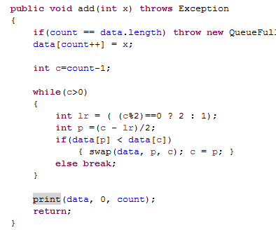
Enqueue to a Heap

Slide 15
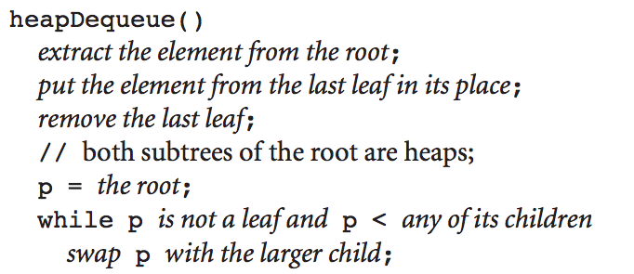
Dequeuing from heap
It means removing root element from heap (the largest)
Then the last leaf is put in its place, this time, moving from the root down the tree.

Slide 16
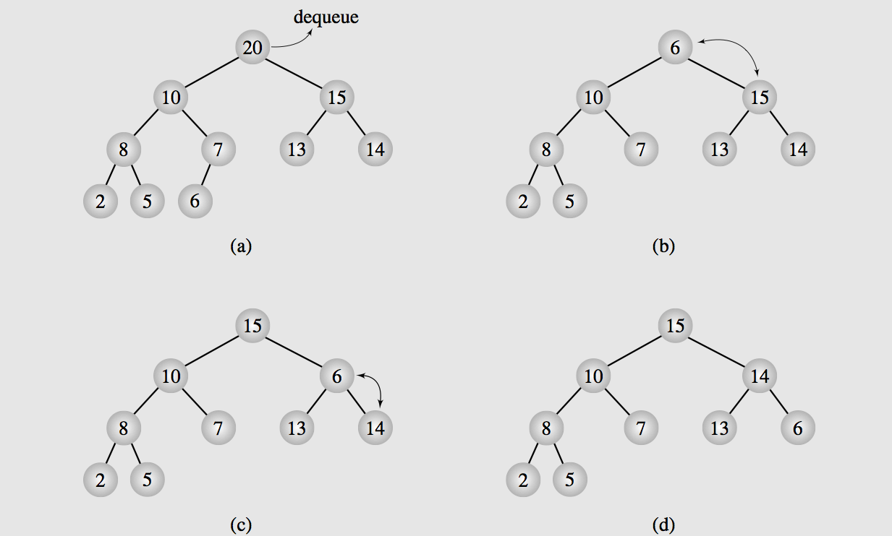
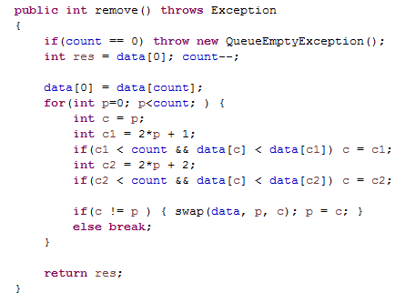
Dequeuing from heap

Slide 17
Heap formation
& heapsort

Slide 18
Heaps and Arrays
Heaps can be implemented as arrays
Each heap is an array
Some arrays are not heaps
So we need to re-organize data in the array to represent a heap
Top-down approach
Start with an empty heap and sequentially include elements into a growing heap.
Floyd algorithm, heap is built bottom-up
Small heaps are formed and repetitively merged into larger heap

Slide 19
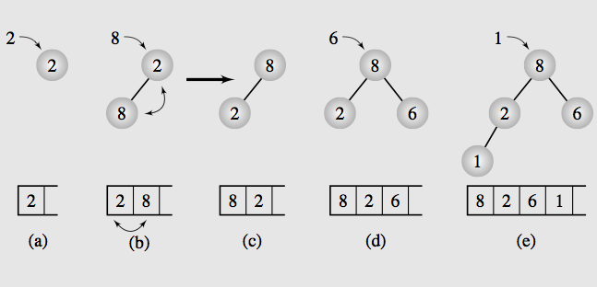
Top-down method
Notes:
http://en.wikipedia.org/wiki/Heapsort#mediaviewer/File:Heapsort-example.gif

Slide 20
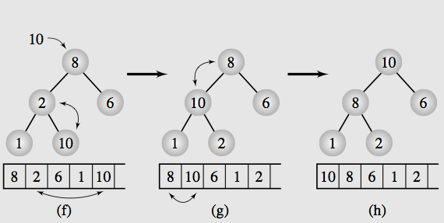
Top-down method

Slide 21
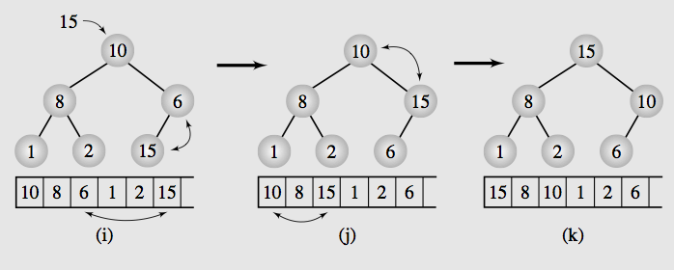
Top-down method

Slide 22
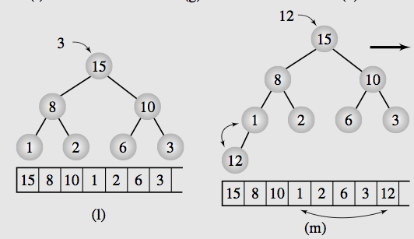
Top-down method

Slide 23
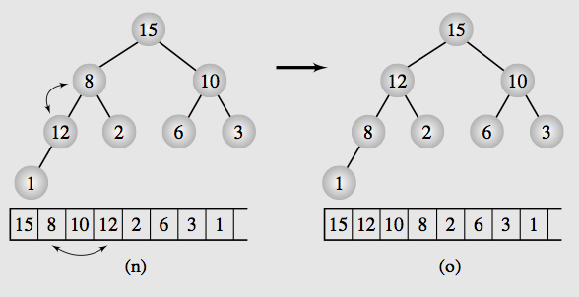
Top-down method

Slide 24
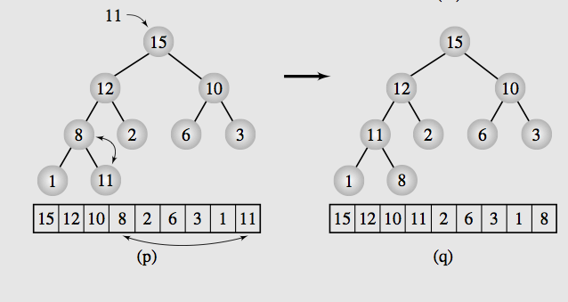
Top-down method

Slide 25
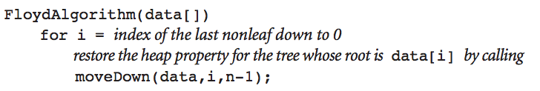
Floyd, Bottom up approach
Start from nonleaf node: data[n/2 -1]
Because we build the tree from left to right, with the left most is the root node and next two elements will be its two children and so on…
[n/2-1] will be the last node which is none-leave
Since in a binary tree: Half of the nodes (if the tree is complete binary tree) will be non-leaves.
First: data[n/2-1] and its children (data[n-1], data[n-2])
Swap data[n/2-1] with its larger child data[n-2] = 12
Next is data[n/2 - 2] and its children (data[n-3], data[n-4])
Swap data[n/2-2] with its larger child data[n-4]
Next is data[n/2-3] = 8, and its children (data[n-5], data[n-6]), the children now is starting to be nonleaf so it starts its merging.

Slide 26
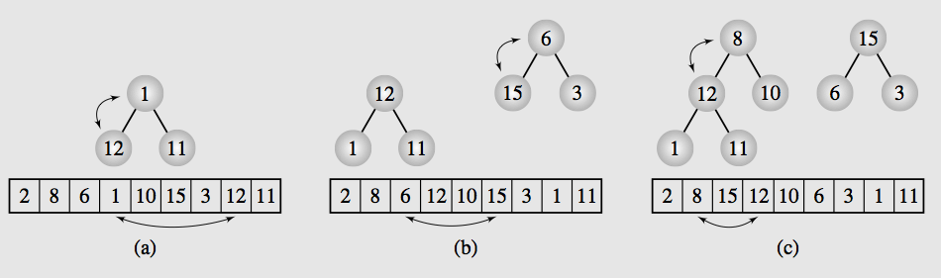
Floyd, Bottom up approach
We need the last parent from last child
1
3
4
7
0
2
5
6
Build 567 >> Build 234 >> Build 123 >> Build 012

Slide 27
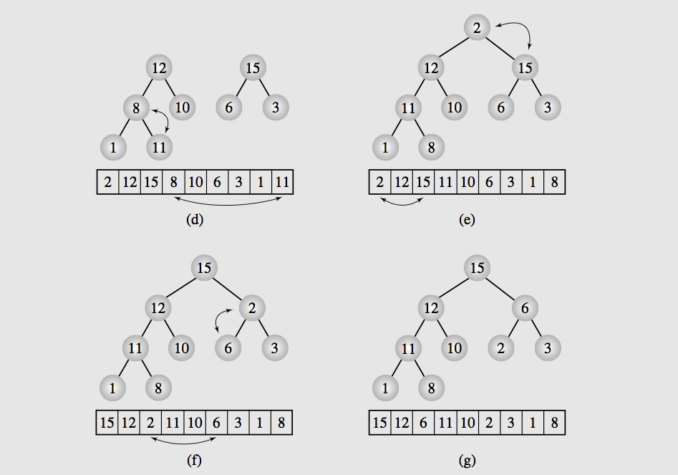
Floyd, Bottom up approach
Notes:
http://en.wikipedia.org/wiki/Heapsort#mediaviewer/File:Heapsort-example.gif

Slide 28
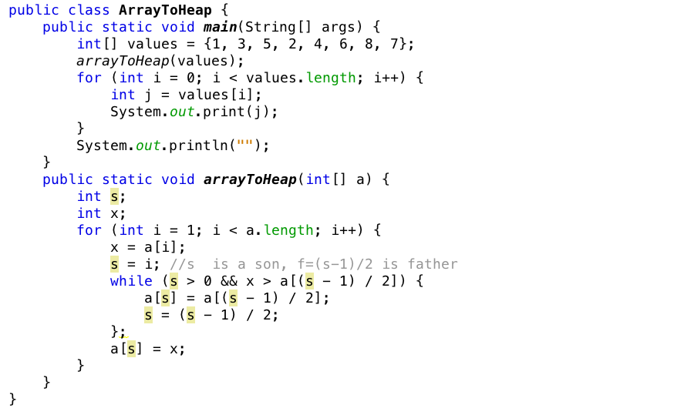
Transforming array to heap
Notes:
http://en.wikipedia.org/wiki/Heapsort#mediaviewer/File:Heapsort-example.gif

Slide 29
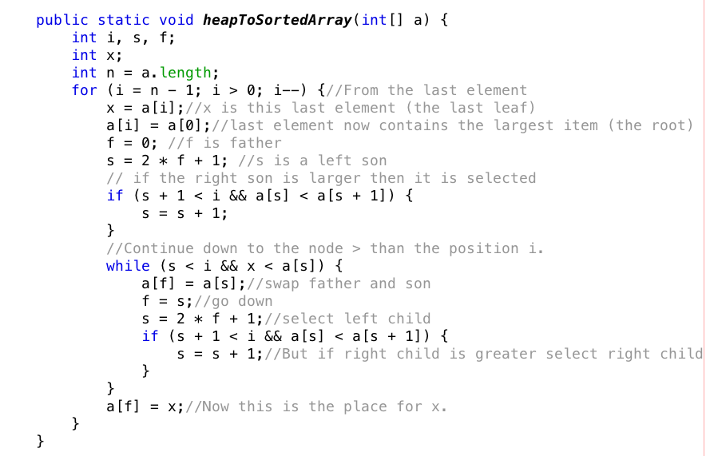
Transforming heap to sorted array
Notes:
http://en.wikipedia.org/wiki/Heapsort#mediaviewer/File:Heapsort-example.gif

Slide 30
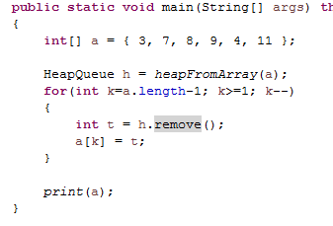
Heap Sort
Turning a normal array into heap array
Using Floyd bottom-up approach
Or using top-down approach
Remove the elements from queue and add to another list
Due to the priority, the elements will create increasing order (min-heap) or decreasing order (max-heap)

Slide 31
AVL tree
(self-balancing BST)

Slide 32
AVL Trees
ALV tree (by Adelson, Velskii, and Landis) is balanced binary search tree with condition
Height of the left and right subtrees of every node differ by at most one
A balance factor is the height of the right subtree minus the height of the left subtree.
ALV tree, balance factors of all nodes should be +1, 0, or -1.
Note also that: Definition of AVL tree is the same as that of the balanced tree.
However, the concept of AVL tree always implicitly includes
the techniques for finding balance factors and
balancing the tree.

Slide 33
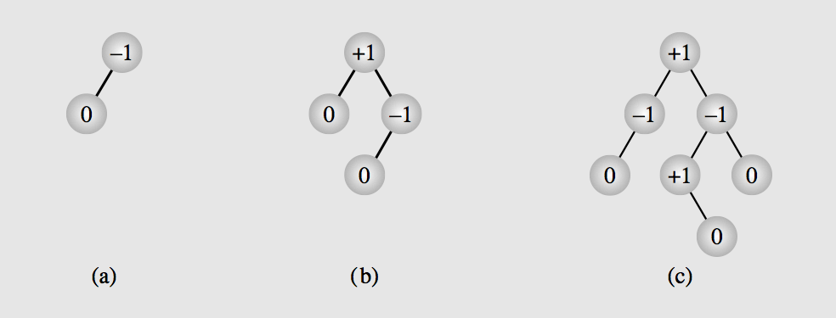
Balance factors of nodes
Is defined as height of the right subtree minus height of left subtree.

Slide 34
Insertion and rebalancing

Slide 35
Insertion in an AVL Tree
After insertion if the balance factor of AVL tree becomes less than -1 or greater than 1, the tree has to be re-balanced.
Four cases, however, two cases to be analyzed and the other two will be symmetrically the same
First case: inserting into the right subtree of the right child
Second case: inserting into the left subtree of the right child

Slide 36
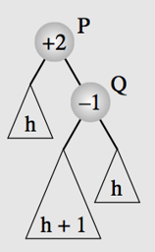
p
Right-left longer
p
Left-right longer
q
q
a
c
a
c
b
b
h
h
h
h
h+1
h+1
p
Right-right longer
p
q
q
Left-left longer
a
b
c
b
a
h
c
h
h
h
h+1
h+1

Slide 37
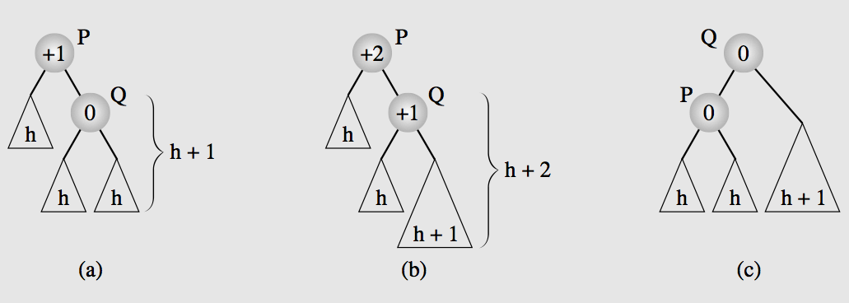
First case: To right subtree of right child
---- child updating
Q.Left = p
q.Right = c
p.Left = a
p.Right = b
Root.left = Q if p on the left
Root.right = Q if p on the right
A = P.left
B = Q.left
C = Q.right
Root = P.parent
Inserting a node to the right subtree of the right child
Rotate Q about P
A
C
B
A
B
C
---- parent updating
A.Parent = p
B.Parent = p
C.Parent = q
P.Parent = q
Q.Parent = root
The outer most is the longest: keep the outer, fix the inner

Slide 38
First case: To right subtree of right child
+1
0
0
0
0
0
0
0
0
0
0

Slide 39
First case: To right subtree of right child
Balance disturbance
+1
+2
0
+1
0
0
0
0
+1
0
0
0
+1
0
0
0

Slide 40
First case: To right subtree of right child
Balance disturbance
P
+1
+2
Q
0
+1
0
0
0
0
+1
0
0
0
+1
0
0
0
Rotate Q about P

Slide 41
First case: To right subtree of right child
P
+1
+2
Q
0
+1
0
0
0
+1
0
0
0
0
+1
0
0
0
Rotate Q about P

Slide 42
First case: To right subtree of right child
P
+1
+2
Q
0
+1
0
0
0
+1
0
0
0
+1
0
0
0
0
Rotate Q about P

Slide 43
First case: To right subtree of right child
P
Q
0
+1
+1
+2
0
0
+1
0
0
0
+1
0
0
0
0
0
Rotate Q about P

Slide 44
First case: To right subtree of right child
Q
0
+1
P
+1
+2
0
0
+1
0
0
+1
0
0
0
0
0
0
Rotate Q about P

Slide 45
First case: To right subtree of right child
Q
0
+1
P
+1
+2
0
0
+1
0
0
+1
0
0
0
0
0
0
Rotate Q about P

Slide 46
First case: To right subtree of right child
Q
0
+1
P
+1
+2
0
+1
0
0
0
+1
0
0
0
0
0
0
Rotate Q about P

Slide 47
First case: To right subtree of right child
Q
0
+1
P
+1
+2
0
+1
0
0
+1
0
0
0
0
0
0
0
Rotate Q about P

Slide 48
First case: To right subtree of right child
Q
0
+1
P
0
+2
+1
+1
+1
0
+1
0
0
0
0
0
0
0
Rotate Q about P

Slide 49
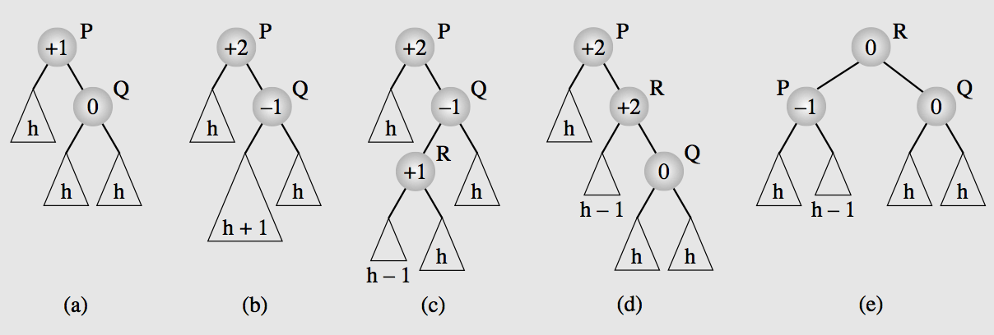
Second case: to left subtree of right child
If(p_left) root.left = R
Else root.right = R
R.Left = P
R.Right = Q
P.Left = A
P.Right = B
Q.Left = C
Q.Right = D
Root = p.parent
P_left = (root.left==p)
A = P.left
B = R.left
C = R.right
D = Q.right
Inserting a node to the left subtree of the right child (more complex)
A double rotation is needed.
First: Rotating R about Q and then
Second: R about P
root
root
R.Parent = root
P.Parent = R
Q.Parent = R
A.Parent = P
B.Parent = P
C.Parent = Q
D.Parent = Q
A
D
D
A
B
C
B
C
The inner is the longer: drag the inner R to top

Slide 50
Second case: to left subtree of right child
Balance disturbance
P
+1
+2
Q
0
-1
0
R
0
0
0
0
+1
0
0
0
0
+1
0
First: Rotate R about Q
Second: Rotate R about P

Slide 51
Second case: to left subtree of right child
P
+1
+2
Q
0
+1
0
R
0
0
0
0
+1
0
0
0
0
+1
0
First: Rotate R about Q
Second: Rotate R about P

Slide 52
Second case: to left subtree of right child
P
+1
+2
0
Q
0
+1
R
0
0
0
+1
0
0
0
+1
0
0
0
First: Rotate R about Q
Second: Rotate R about P

Slide 53
Second case: to left subtree of right child
P
+1
+2
0
R
Q
0
+1
0
+1
0
0
0
0
+1
0
0
0
0
First: Rotate R about Q
Second: Rotate R about P

Slide 54
Second case: to left subtree of right child
P
+1
+2
R
0
0
+1
Q
0
+1
0
0
0
0
+1
0
0
0
0
First: Rotate R about Q
Second: Rotate R about P

Slide 55
Second case: to left subtree of right child
P
+1
+2
R
0
0
+1
Q
0
+1
0
0
0
0
0
+1
0
0
0
First: Rotate R about Q
Second: Rotate R about P

Slide 56
Second case: to left subtree of right child
P
+1
+2
R
0
+1
0
Q
0
+1
0
0
0
0
0
+1
0
0
0
First: Rotate R about Q
Second: Rotate R about P

Slide 57
Second case: to left subtree of right child
P
+1
+2
R
0
+1
0
Q
0
+1
0
0
0
0
0
+1
0
0
0
First: Rotate R about Q
Second: Rotate R about P

Slide 58
Second case: to left subtree of right child
P
+1
+2
R
0
+1
Q
0
0
+1
0
0
0
0
0
+1
0
0
0
First: Rotate R about Q
Second: Rotate R about P

Slide 59
Second case: to left subtree of right child
P
+1
+2
R
0
+1
Q
0
+1
0
0
0
0
+1
0
0
0
0
0
First: Rotate R about Q
Second: Rotate R about P

Slide 60
Second case: to left subtree of right child
R
0
+1
P
Q
0
+1
+1
+2
0
0
0
+1
0
0
0
0
0
0
First: Rotate R about Q
Second: Rotate R about P

Slide 61
Second case: to left subtree of right child
R
0
+1
P
Q
0
+1
+1
+2
0
0
0
+1
0
0
0
0
0
0
First: Rotate R about Q
Second: Rotate R about P

Slide 62
Second case: to left subtree of right child
R
0
+1
P
Q
0
+1
+1
+2
0
0
+1
0
0
0
0
0
0
0
First: Rotate R about Q
Second: Rotate R about P

Slide 63
Second case: to left subtree of right child
R
0
+1
P
Q
0
+1
+1
+2
0
0
+1
0
0
0
0
0
0
0
First: Rotate R about Q
Second: Rotate R about P

Slide 64
Second case: to left subtree of right child
R
0
+1
P
Q
0
-1
+1
+2
+1
0
+1
0
0
0
0
0
0
0
First: Rotate R about Q
Second: Rotate R about P

Slide 65
In a larger AVL tree
ALV tree seen before might be child of some other node in the tree
If a node is entered to the tree and the balance of P is disturbed and then restored.
Does extra work needed to be done for the predecessor(s) of P?
Fortunately, NO, since after rotation height of the new tree is exactly the same as that of the previous one.
Which mean the balance factor of parent of the new root (Q in previous example) remains the same

Slide 66
In a larger AVL tree
Now the general solution is:
Find a node P for which the balance factor becomes unacceptable after a node is inserted
This is detected by moving up toward the root from newly inserted node
If the old balance factor is +-1 it might be changed to +-2
The first node whose balance factor is changed to +-2 becomes the root P of a subtree that we need to balance
Balance factors for the nodes, above this node doesn’t need to be updated
Coz after balancing new tree has the same height as the old one

Slide 67
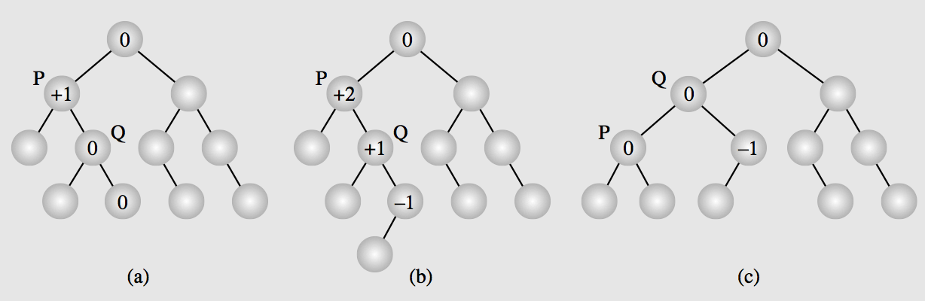
In a larger AVL tree
From the inserted node
Find balance factors of all nodes on this path
Up until finding a node with balance factor = +2
This node P is the root node for us to apply rotation algorithm (2 cases studied above)

Slide 68
Deletion and rebalancing

Slide 69
Deletion
First, apply deleteByCopying() to delete the node
After the node is deleted, balance factors are updated from the parent up to the root.
For each node in this path, whose balance factor becomes +-2, a single or double rotation has to be done.
Important, it doesn’t stop after the first ode P is found, as in case of Insertion.

Slide 70
Cases of immediate rotation
Four cases + corresponding symmetric cases.
Case 1: A root node P with balance factor +1 and right child Q with balance factor +1
Case 2: A root node P with balance factor +1 and right child Q with balance factor 0
A root node P with balance factor +1 and right child Q with balance factor -1
Case 3: The left child R of Q has balance factor of -1
Case 4: The right child R of Q has balance factor of +1
https://docs.google.com/document/d/1q-AwBOF_wFUZMTz0gRVCGNY_Fge3hwIW_s6IX01z-IE/edit?usp=sharing

Slide 71
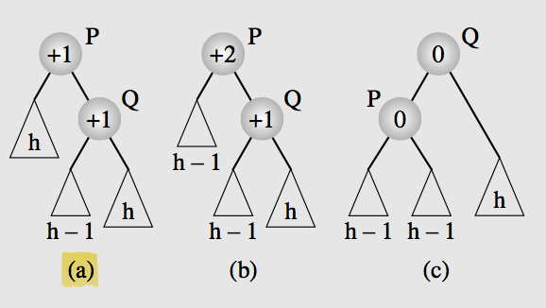
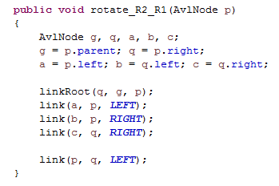
Case 1: P: +1, Q: +1
G = p.parent
Q = p.right
A = p.left
B = p.left
C = q.right
P.Left = a
p.Right = b
q.Left = p
q.Right = c
G.left=Q if G.left==p
G.right=Q if G.right==p
Case 1: A root node P with balance factor +1 and right child Q with balance factor +1
Rotate Q about P
P.parent = q
c.Parent = q
a.Parent = p
b.Parent = p
q.Parent = G
a
b
b
c
a
c

Slide 72
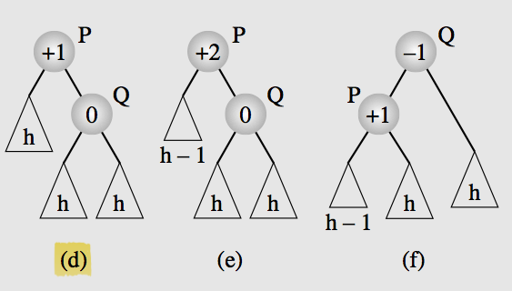
Case 2: P:+1, Q:0
Case 2: A root node P with balance factor +1 and right child Q with balance factor 0
Rotate Q about P (So the same as case 1)

Slide 73
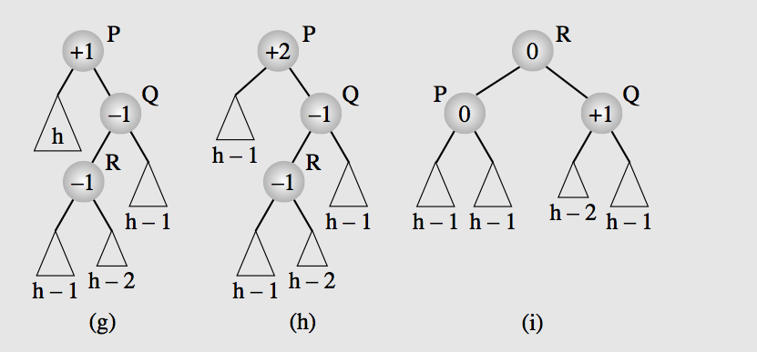
Case 3: P:+1, Q:-1, R:-1
A root node P with balance factor +1 and right child Q with balance factor -1
Case 3: The left child R of Q has balance factor of -1
First: Rotate R about Q
Second: Rotate R about P

Slide 74
A
D
A
B
c
D
B
c
+ updating children
p.parent.left = r if p.parent.left==p
p.Left = a
p.Right = b
q.Left = c
q.Right = d
r.Left = p
r.Right = q
+ updating parent
r.Parent = p.parent (first thing)
a.Parent = p
b.Parent = p
c.Parent = q;
d.Parent = q;
p.Parent = r;
q.Parent = r;

Slide 75
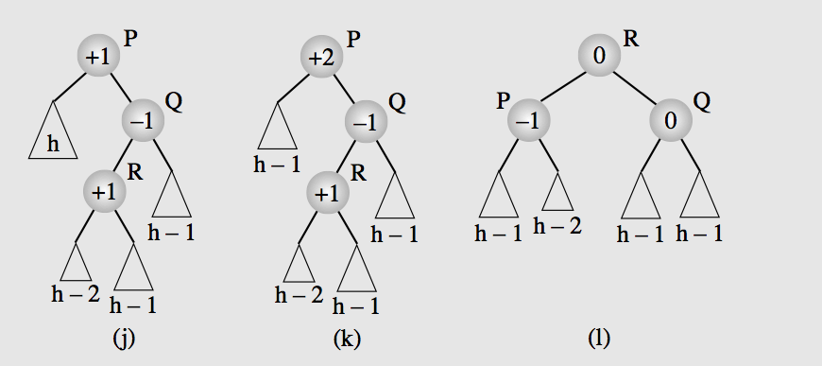
Case 4:
A root node P with balance factor +1 and right child Q with balance factor -1
Case 4: The right child R of Q has balance factor of +1
First: Rotate R about Q
Second: Rotate R about P
(Same as case 3, both cases can be processed in the same way)

Slide 76
Objectives
Trees, Binary Trees, and Binary Search Trees
Tree Traversal
Implementing Binary Trees
Binary Search Tree
Insertion
Deletion
Balancing a Tree
The DSW Algorithm (*)
AVL Trees
Heaps
Polish Notation and Expression Trees (*)
Reading at home
Notes:
Note: (*) Means that students are required to understand essential features only (the problem explanation, definitions, the outline of algorithms…), not in details.

Slide 77
Tree visualization
+ y is trivial
+ x is the offset from center x0
+ root.x = x0
+ left = root.left
+ left.x = root.x -
+ compute width
+ placing

Slide 78
Assuming complete tree
If the tree has h layers then it will have 2^(h-1) leaves
We compute the tree with 2^(h-1) width and h height as the base rectangle

